Slide 1
P-CART

Slide 2
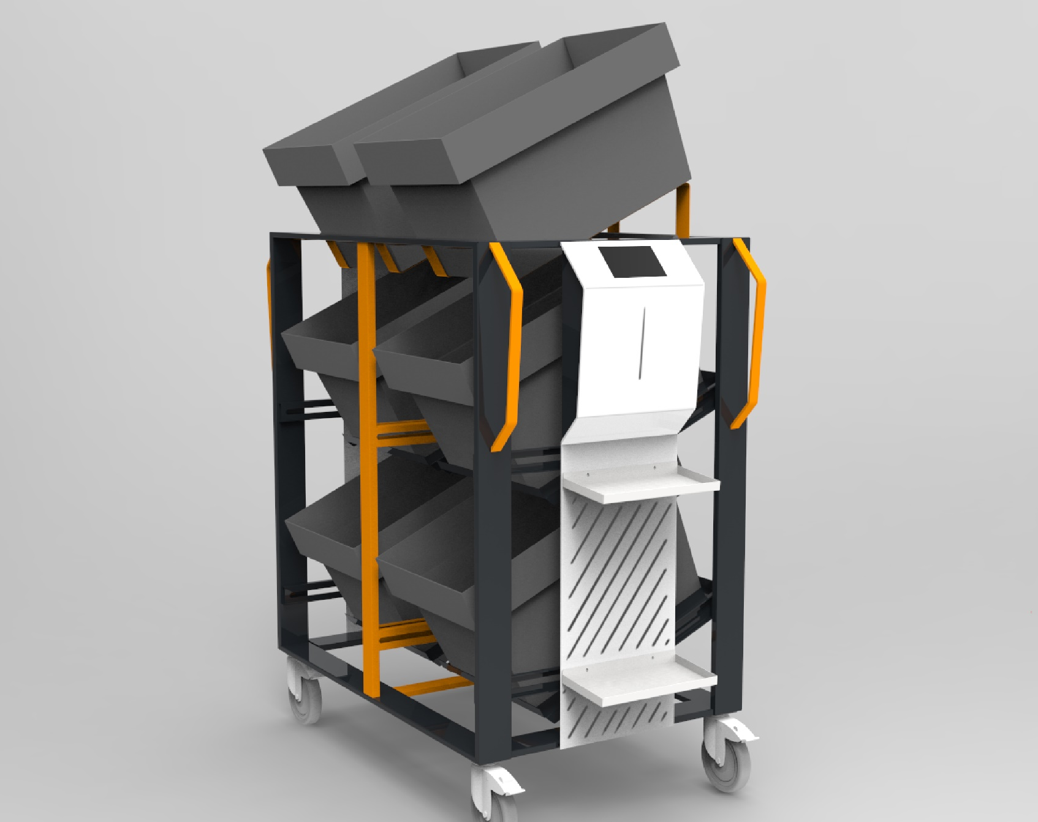
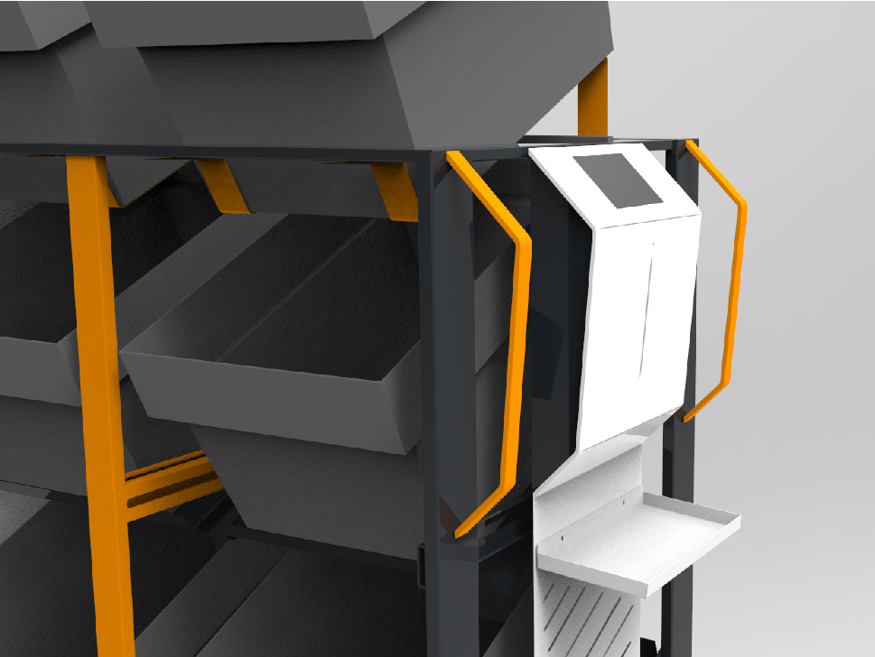
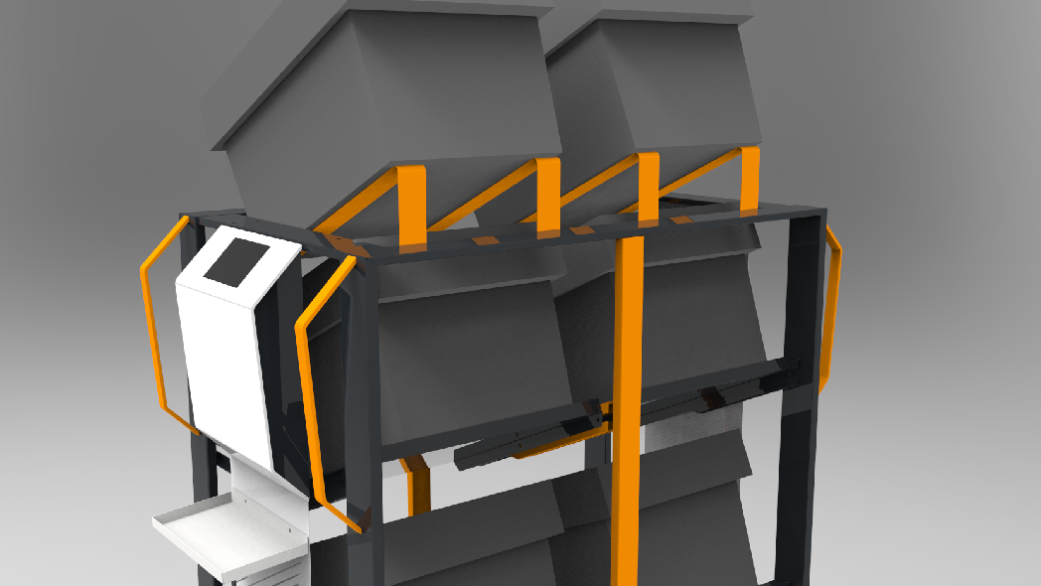

Slide 3
P-CART
Benefits:
All order details showed on the P-Cart Screen
Speeding up the picking process, thanks to picking route optimization
The possibility of picking of 6 orders at the same time
Communication LED - backlit baskets in which to place products
Minimization of human error
Development of new technologies

Slide 4
P-CART
Principle of operation:
Automatic data synchronization
Sorting / grouping of orders
Orders showed on the screen built into the P-Cart
Start picking - the most optimized route of passage is displayed
Product barcode scan
Backlight by LED of the basket to which you should put the products
Map shows the new route passage leading to the next product
Picking complete

Slide 5
P-CART
Key components:
PC compatible electronic board: Android or Microsoft Windows 10
7” touch monitor
Wi-fi module
Power supply with lithium-ion battery supporting up to 16 hours operation
Wireless barcode scanner
6 LED indicators connected to basket compartments to support picking procedure.

Slide 6
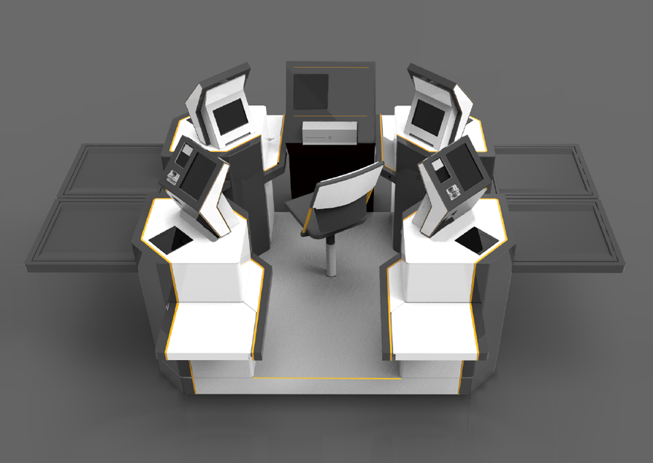
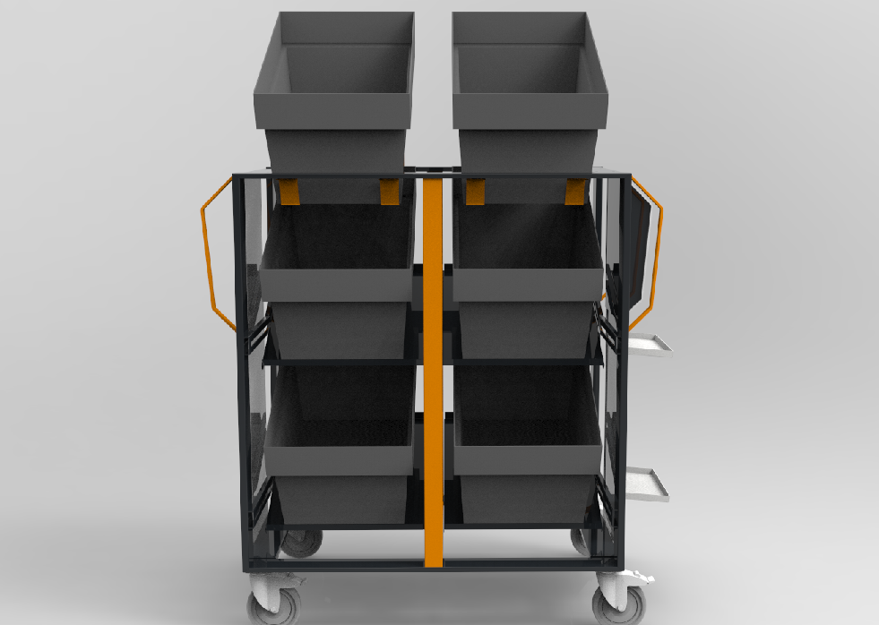
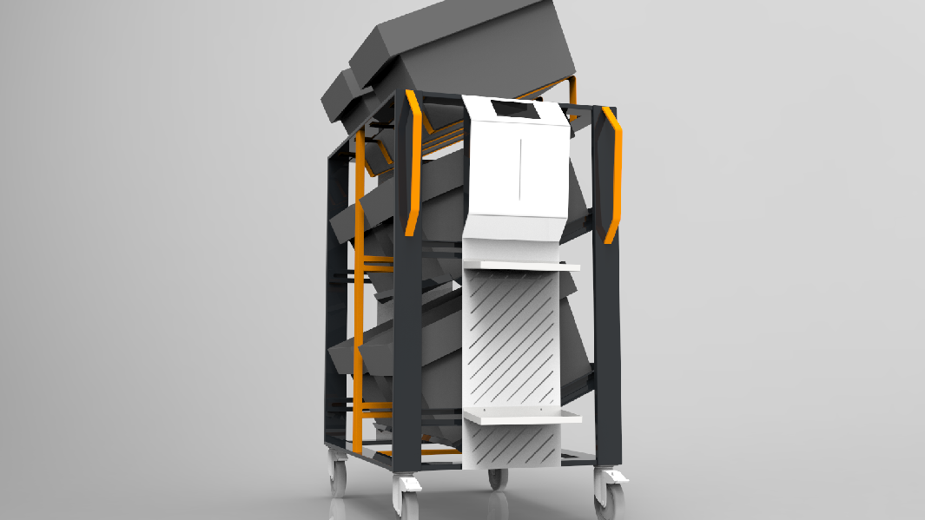
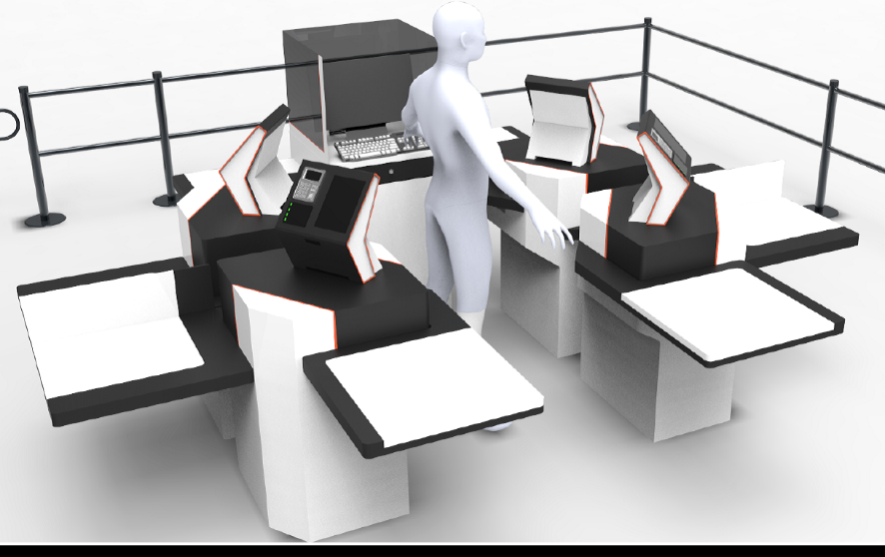
P-CART
Overview:
Reduction of human error
Picking process optimization
Many colour and basket configuration options

Slide 7
CONTACT
Hemitech….

